Slide 1
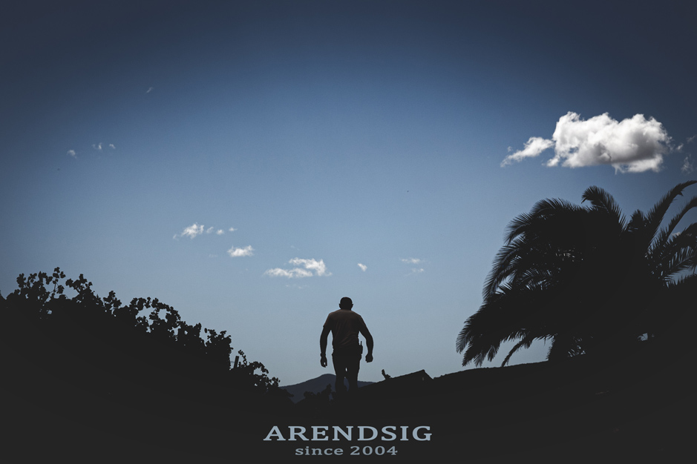
ARENDSIG ESTATE
MAIDEN VINTAGE: 2004
WINEMAKER: Lourens van der Westhuizen – 5th Generation
1st Generation Winemaker
ESTATE SIZE: 86ha
30ha under vines
56 ha protected natural vegetation

Slide 2
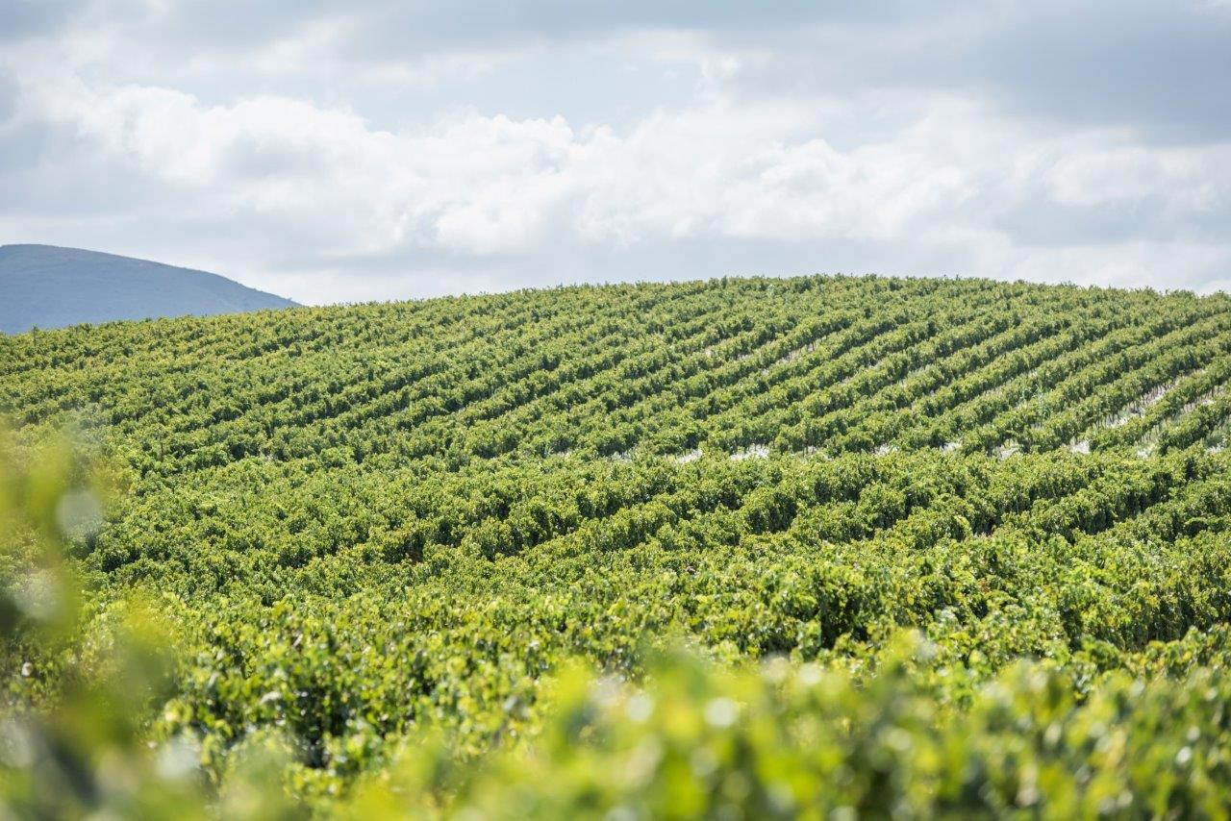
VINEYARD PHILOSOPHY
Virgin soils developed and vines planted in 2003 & 2004
Older vineyards produce consistent, lower yielding, well balanced fruit
We have worked tirelessly to create more life in the vineyards
Protecting all living organisms, insects and vegetation to create and maintain healthy soils for our vineyards to grow in.
All of this brought back more than 90 bird species, small antelope and much more animal life co-existing naturally in the vineyards

Slide 3
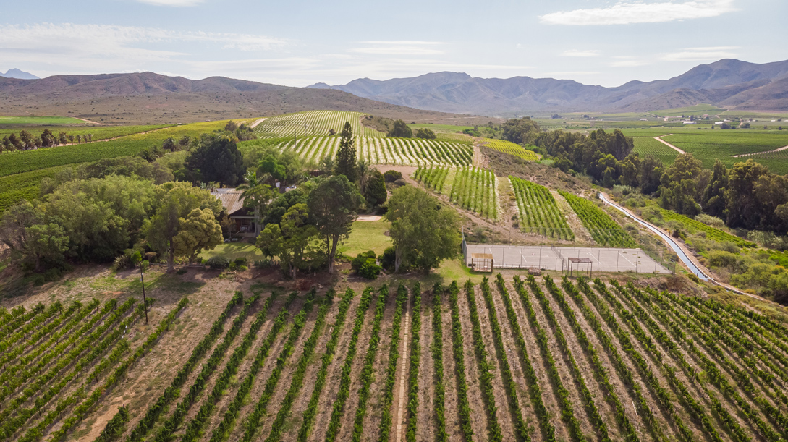
ESTATE SOIL
Predominantly Limestone Rich, calcrete rock formation
Rocky and Arid soil base – naturally lower yielding vineyards
CLIMATE
Diurnal Growing Season Temperature = 15 C
Average Max Temperature in warmest month = 30.82 C
Average Min Temperature in warmest month = 14.43 C
Average annual rainfall = 240mm
Semi – Arid Geographical Area
LOCATION
REGION: Robertson, South Africa
WARD: Southern Appellation - Bonnievale
78km from closest coastline

Slide 4
WINEMAKING PHILOSOPHY:
“My philosophy is to create great single vineyard wines from unique soil, climate and location. It’s the soil with all the microbes, cycle of elements and the help of living organisms that create the heartbeat for my vines. The vineyards location in relation to the sun and wind direction, as well as a holistically favourable climate, influences the expression of each block. Vinified with minimal interference”

Slide 5
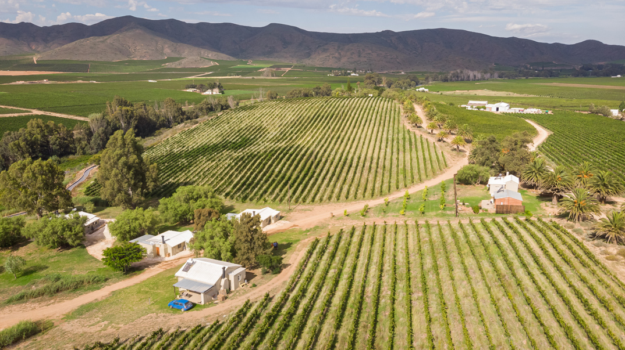
EAST FACING
Klein Karoo & Central South Africa
Cabernet Sauvignon Blok A9
Pinot Noir
Blok A18
Pinotage
Blok A19
Chardonnay Blok A15

Slide 6
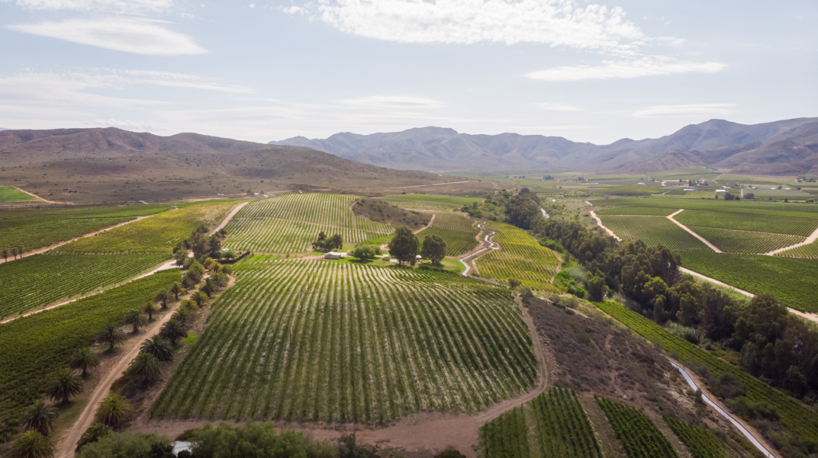
WEST FACING
Cape Town 100km due West
Riviersonderend Mountains
Chardonnay Blok A15
Pinotage
Blok A19
Pinot Noir
Blok A18
Cabernet Sauvignon Blok A9
Sauvignon blanc
Blok A10

Slide 7
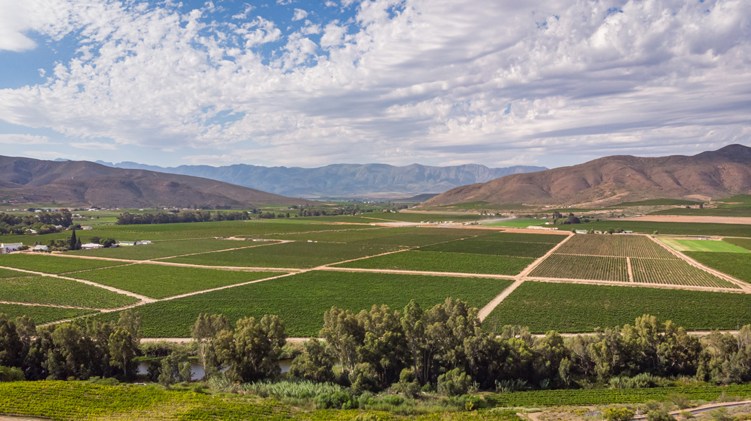

NORTH FACING
Langeberg Mountains

Slide 8
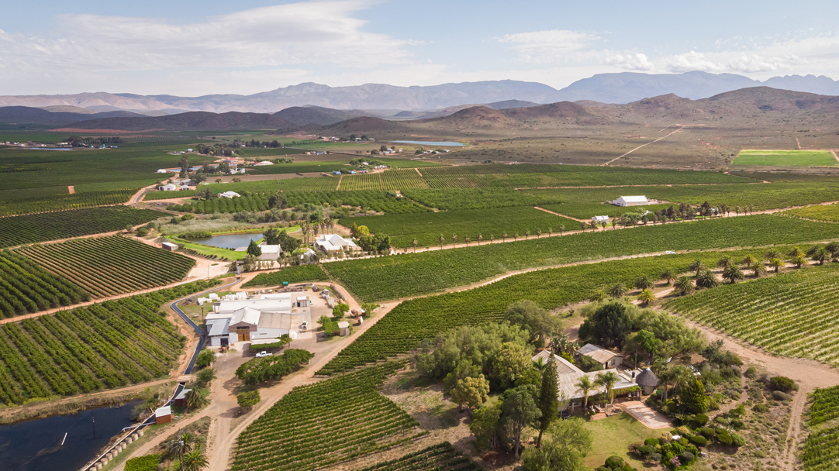
SOUTH FACING
SOUTHERN TIP OF AFRICA
CAPE AGULHAS
100km Due South
Pinotage Blok A19
Cabernet Sauvignon
Blok A9
Pinot Noir Blok A18
Sauvignon blanc Blok A10

Slide 9
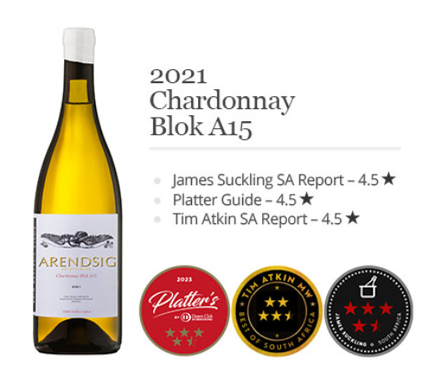
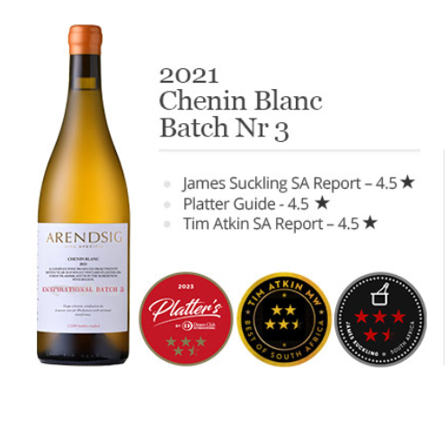
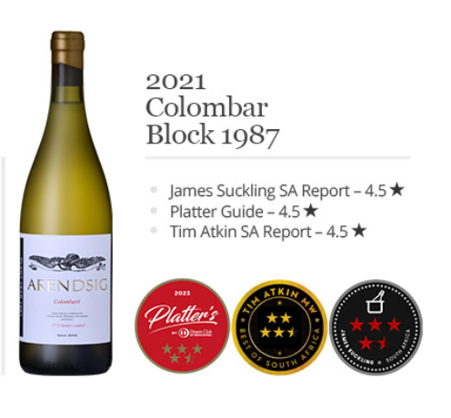
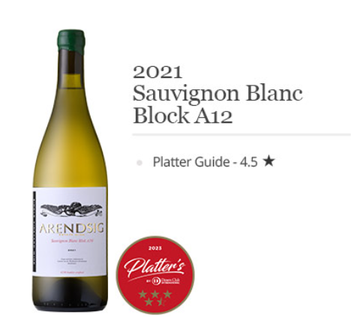

Slide 10
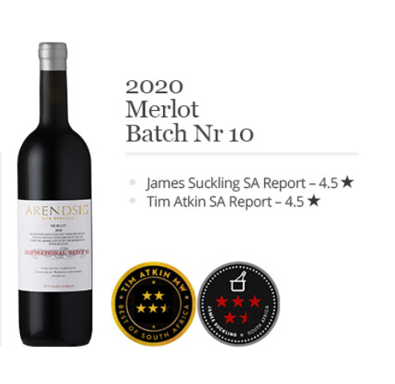
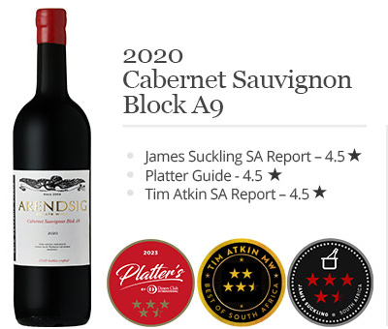
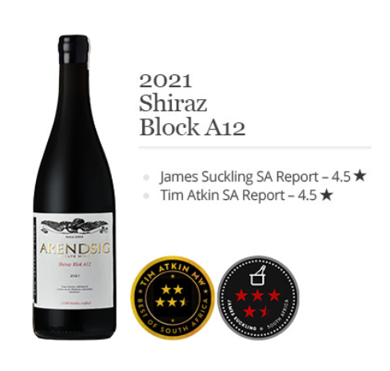

Slide 11
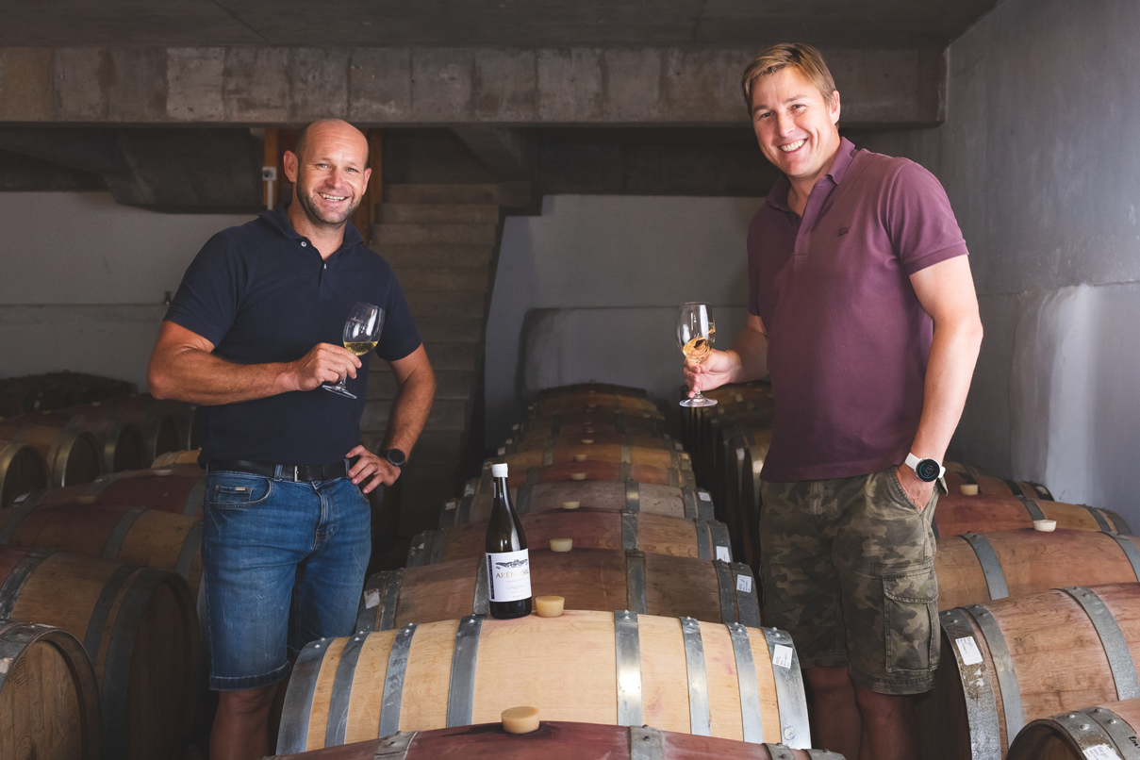
THANK YOU FOR YOUR WONDERFUL AND CONTINUED SUPPORT
lourens@arendsig.co.za marketing@arendsig.co.za

